Slide 1
HOSPITALITY ANALYTICS DASHBOARD
Revenue, Occupancy & Strategic Insights for AtliQ Hotels
📊 Power BI & DAX
📅 May – July
🏙️ 4 Cities
🏨 7 Properties
Data-Driven Hospitality | Ashika Jain

Slide 2
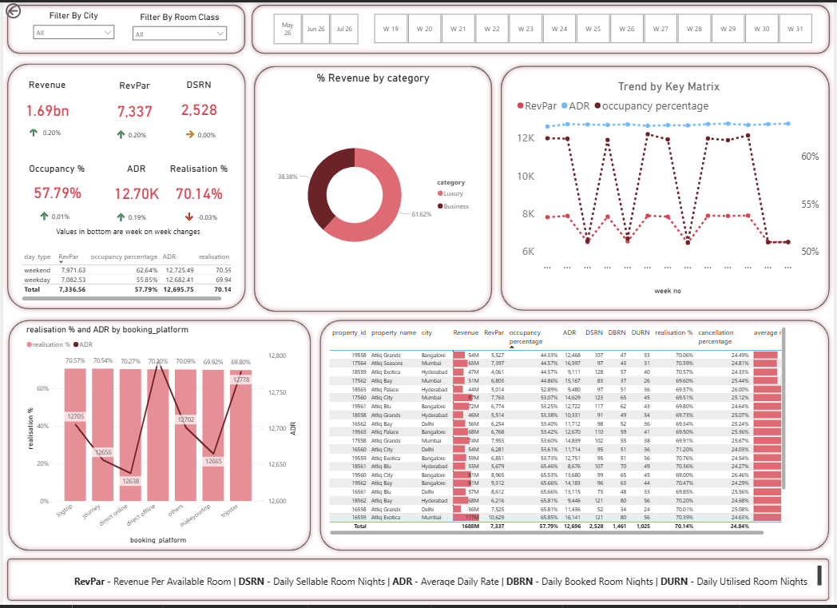
PROJECT OVERVIEW
Total Revenue
RevPAR
1.69 bn
7,337
Occupancy
ADR
[ Insert Full Dashboard Screenshot Here ]
57.79%
12.70K
Realisation %
Properties
70.14%
7
3 months of data | 6 cities | May–July | Power BI & DAX

Slide 3
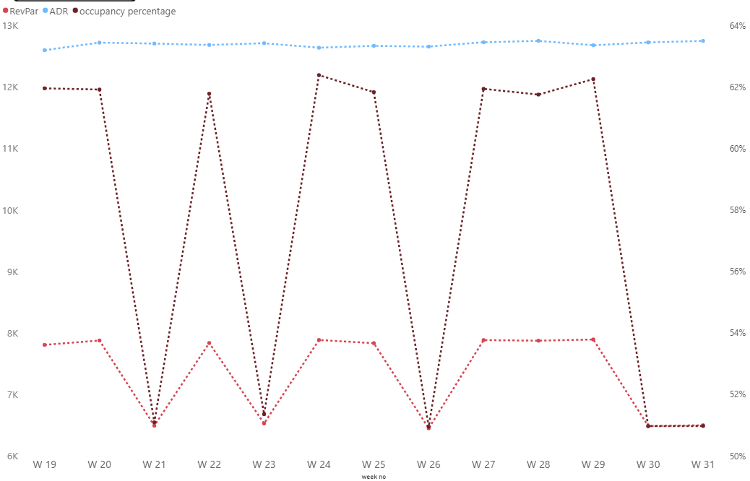
INSIGHT 01
The Hotel Is Not Using Dynamic Pricing
📉 ADR is flat across all 13 weeks
Occupancy fluctuates week over week but the rate never adjusts to match demand.
RevPAR changes only because occupancy changes — not pricing.
[ Insert: Trend by Key Matrix Line Chart Screenshot ]
✅ RECOMMENDATION
Adopt dynamic pricing. Charge higher on weekends, holidays & peak periods. Revenue gain with zero extra operational cost.

Slide 4
INSIGHT 02
Weekend Demand Is Higher But Rates Are The Same
WEEKEND
WEEKDAY
💡 The Gap
62.64%
55.85%
RevPAR difference between weekend and weekday is driven entirely by occupancy — not rate. The hotel fills more rooms on weekends but barely charges more.
Occupancy
Occupancy
12,725.49
12,682.41
ADR
ADR
✅ RECOMMENDATION
7,336.56
7,082.53
Introduce weekend premium pricing. 10% ADR increase on weekends directly lifts RevPAR.
RevPAR
RevPAR

Slide 5
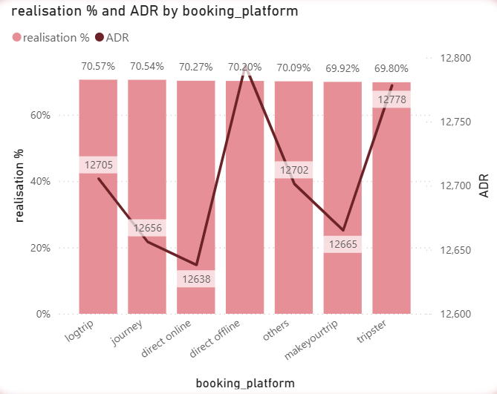
INSIGHT 03
Booking Platform Strategy Needs Rethinking
🔍 OTA bots monitor prices across platforms.
If a hotel lists cheaper rates elsewhere, the scraper on different
application reduces the hotel's visibility & rating.
Directly cutting website prices backfires on OTA rankings.
Direct offline has no commission but also lower ADR — opportunity exists.
[ Insert: Realisation % & ADR by Booking Platform Bar Chart ]
✅ RECOMMENDATION
Keep listed prices stable across OTAs. Launch direct booking coupon program
on our own website for rate relaxation
— protects OTA ratings while cutting commission costs.

Slide 6
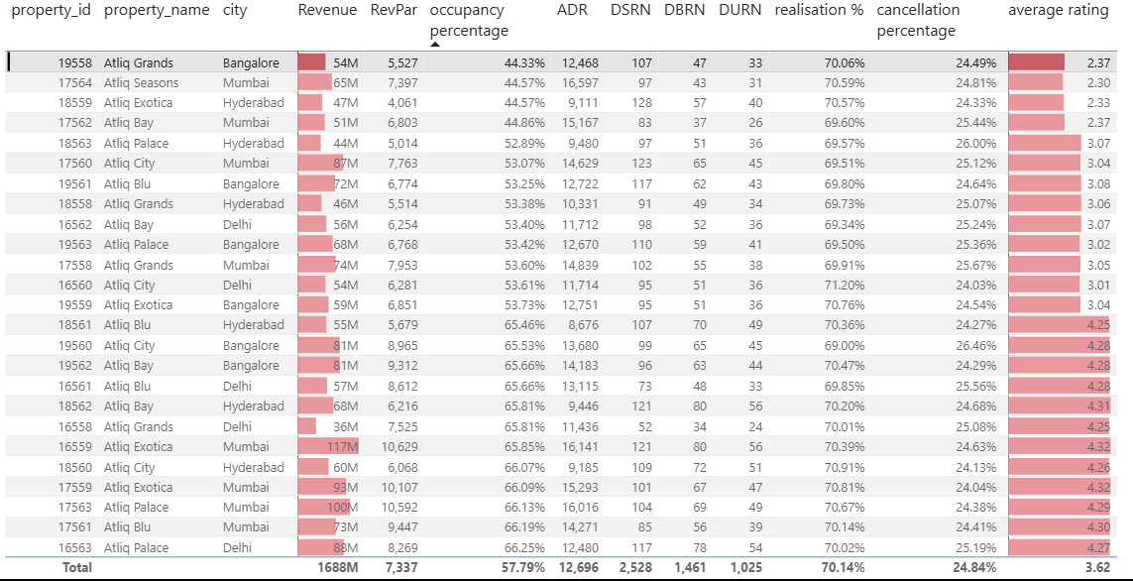
INSIGHT 04
Atliq Grands Bangalore is Underperforming
Avg Rating — Lowest
2.37 ⭐
Occupancy %
Lowest
Low rating → Low occupancy → Low revenue. This is not a pricing problem. It is an operational & experience problem.
✅ ACTION
Root cause analysis on guest reviews → Check photos vs reality → Fix top complaints → Improve rating → Recover occupancy

Slide 7
PRIORITIZED RECOMMENDATIONS
Dynamic & Weekend Pricing
HIGHEST IMPACT
01
ADR is flat — no dynamic pricing in use. Even a 10% weekend rate increase directly lifts RevPAR with zero extra cost.
⏱ Implement immediately
Direct Booking Coupon Program
MEDIUM IMPACT
02
OTA bots penalize lower direct prices. Use coupons for rate relaxation on direct channel to protect OTA rankings while reducing commission dependency.
⏱ Medium term
Fix Atliq Grands Bangalore
URGENT
03
Lowest occupancy + lowest rating (2.33★). Audit reviews, check property conditions, close service gaps. Rating improvement = occupancy recovery.
⏱ Urgent

Slide 8
TOOLS & METHODOLOGY
📊 Power BI
🧮 DAX
🗃️ Data Model
Interactive dashboard with city and room class filters
Custom measures for KPIs, week-on-week change indicators
3 months | May–July 4 cities | 7 properties
🔍 Tooltips
📈 KPI Tracking
🏨 Domain
Custom tooltip pages for Revenue, ADR, DSRN, Occupancy, Realisation %
Weekly trend analysis with WoW change arrows
Hospitality analytics with business insight framing

Slide 9
THANK YOU
Insights derived from data. Decisions driven by strategy.
Ashika Jain
B.Tech CSE | Medicaps University, Indore

